Slide 1
Bangla Sign Language Detection using Machine Learning
Md. Mehedi Hasan
221-15-5976
Department of CSE
Daffodil International University
Md. Abbas Ali Khan
Assistant Professor
Department of CSE
Daffodil International University

Slide 2
Outline
Introduction
Problem Statement
Motivation and Objective
Related Works
Comparison Between Existing Works
Gap Analysis
Proposed Methodology
Q & A

Slide 3
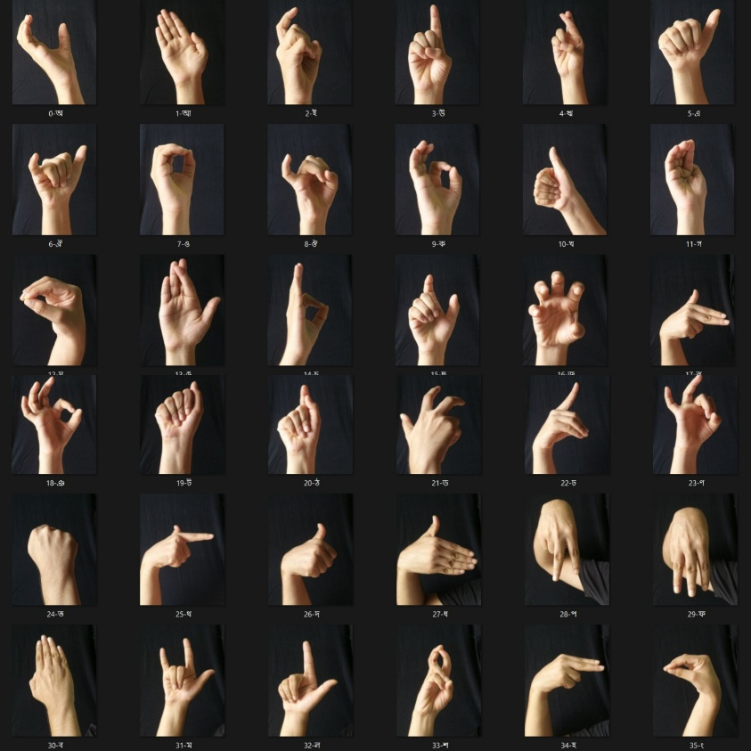
Introduction
Sign language is a technique that uses a variety of hand movements to share ideas. People who can't speak often use sign language to express their feelings.
By using a variety of machine learning techniques, I will attempt to recognize this Bengali sign language and translate it into text and speech for this project.

Slide 4
Problem Statement
Communication barriers: Deaf individuals face challenges in interacting with hearing people due to limited human sign language interpreters.
Existing issues in BdSL detection: Variability in gestures, environmental factors (lighting), limited datasets, and low real-time performance.
Specific challenges: Many systems achieve high accuracy in controlled settings but fail in dynamic, real-world scenarios

Slide 5
Motivation
We see many people around us who cannot speak, who cannot express their feelings properly, so i have decided to create this project, keeping in mind that these mute people who cannot speak can express their feelings with ordinary people. Through this, I believe that it is possible to eliminate the gap between ordinary people and these disabled mutes in our society.

Slide 6
Objective
The primary objective of this project is to develop a real-time Sign Language Detection System using machine learning techniques(CNN, MobileNetV2, VGG16, SVM, Random Forest etc) to bridge communication barriers between hearing-impaired individuals and the broader community.

Slide 7
Related Works
Shanta et al. (2018) explored BdSL detection using SHIFT and CNNs, focusing on 36 signs representing BdSL. The study did not specify the achieved accuracy [1].
Urmee et al. (2019) developed a BdSL to Text-Speech Translator using CNNs, achieving 98.93% accuracy [2].
Haque et al. (2018) utilized Faster R-Convolutional Neural Networks (CNNs) for BdSL detection, reporting an accuracy of 98.2% [5].
Talukder et al. (2020) implemented real-time BdSL detection with sentence and speech generation using YOLOv4, achieving 97.95% accuracy [6].
Hossein et al. (2020) employed a novel Deep Convolutional Neural Network (CNN) for BdSL detection, achieving an exceptional accuracy of 99.96% [16]
Saquib et al. (2020) combined CNNs and wearable sensors for BdSL detection, reporting 96% accuracy [17].
Chowdhury et al. (2021) employed Artificial Neural Networks (ANNs) and Support Vector Machines (SVMs) for BdSL detection, achieving a maximum accuracy of 84.11% [18].

Slide 8
Comparison Between Existing Works
Study | Model/Approach | Accuracy | Limitations
Shanta et al. (2018) | SHIFT, CNNs (BdSL, 36 signs) | Not specified | Accuracy not Mentioned.
Urmee et al. (2019) | CNNs (BdSL to Text-Speech) | 98.93% | High accuracy but may face challenges in real-time processing.
Haque et al. (2018) | Faster R-CNN (BdSL) | 98.2% | Computationally intensive; may struggle with real-time performance.
Talukder et al. (2020) | YOLOv4 (BdSL, Real-Time with Sentence/Speech) | 97.95% | High accuracy but complex model; may face challenges in low-resource environments.
Hossein et al. (2020) | Novel Deep CNN (BdSL) | 99.96% | Exceptionally high accuracy; potential overfitting risk or limited testing on diverse datasets.
Saquib et al. (2020) | CNNs, Wearable Sensors (BdSL) | 96% | Dependency on wearable sensors.
Chowdhury et al. (2021) | ANN, SVM (BdSL) | 84.11% | Lower accuracy;

Slide 9
Gap Analysis
Limited Real-Time Capability: Many studies (e.g., Hossein et al., 99.96%) excel in accuracy but lack real-time processing for dynamic environments.
Dataset Constraints: Low diversity in BdSL datasets; e.g., Shanta et al. limited to 36 signs, ignoring complex sentences or regional variations.
Hardware Dependency: Sensor-based approaches (e.g., Saquib et al., 96%) not scalable; vision-based (e.g., Aich et al., 92.70%) suffer from occlusion/lighting.
Lower Accuracies in General SL: ASL/Cyrillic studies (71.3%-85%) indicate need for better generalization; BdSL gaps in hybrid models.
Overall Gap: No integrated system combining CNNs, sensors, and speech for BdSL in low-resource settings.

Slide 10
Proposed Methodology
Overview: Lightweight hybrid model integrating MobileNetV2 for efficient detection and sensor fusion for accuracy enhancement in BdSL recognition.
Steps:
1. Data Collection: Custom BdSL dataset with 50+ signs, including variations.
2. Preprocessing: Resizing, Normalization, Augmentation.
3. Model Architecture: Transfer learning on pre-trained MobileNetV2 + LSTM for sequence modeling.
4. Training: Optimize with Adam; evaluate via confusion matrix.
5. Output: Real-time gesture-to-text/speech translation.
Expected Outcomes: >98% accuracy; reduced false positives via tuning, leveraging MobileNetV2's efficiency for mobile deployment.

Slide 11
THANK YOU

